Slide 1
Displaying Data

Slide 2
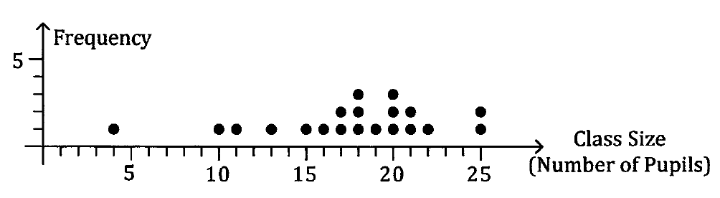
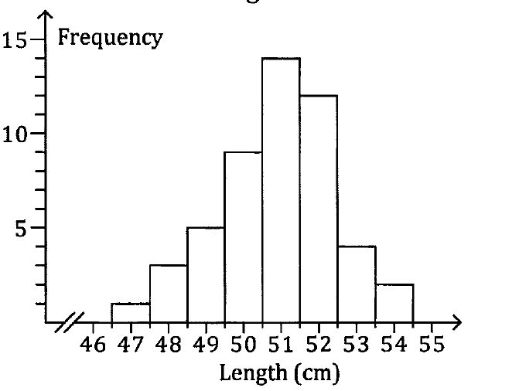
How do we display numerical data?
Dot frequency diagram
Frequency histogram

Slide 3
Dot frequency diagram
Discrete data – number of pupils, not continuous.
y-axis is always frequency
x-axis is always numbers (in this case, integer)

Slide 4
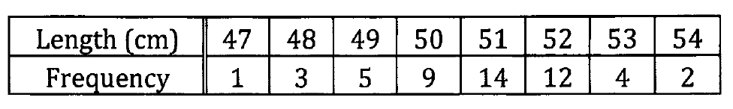
Frequency histogram
Length – continuous data
50 cm – between 49.5 to 50.5

Slide 5
Frequency histogram
No gaps between the bar except when frequency = 0.
Usually have 6 – 10 equal intervals.
y-axis is always frequency
x-axis is always numbers
The frequency can be expressed in
Relative frequency – fraction of the whole
Percentage frequency – percentage of the whole

Slide 6
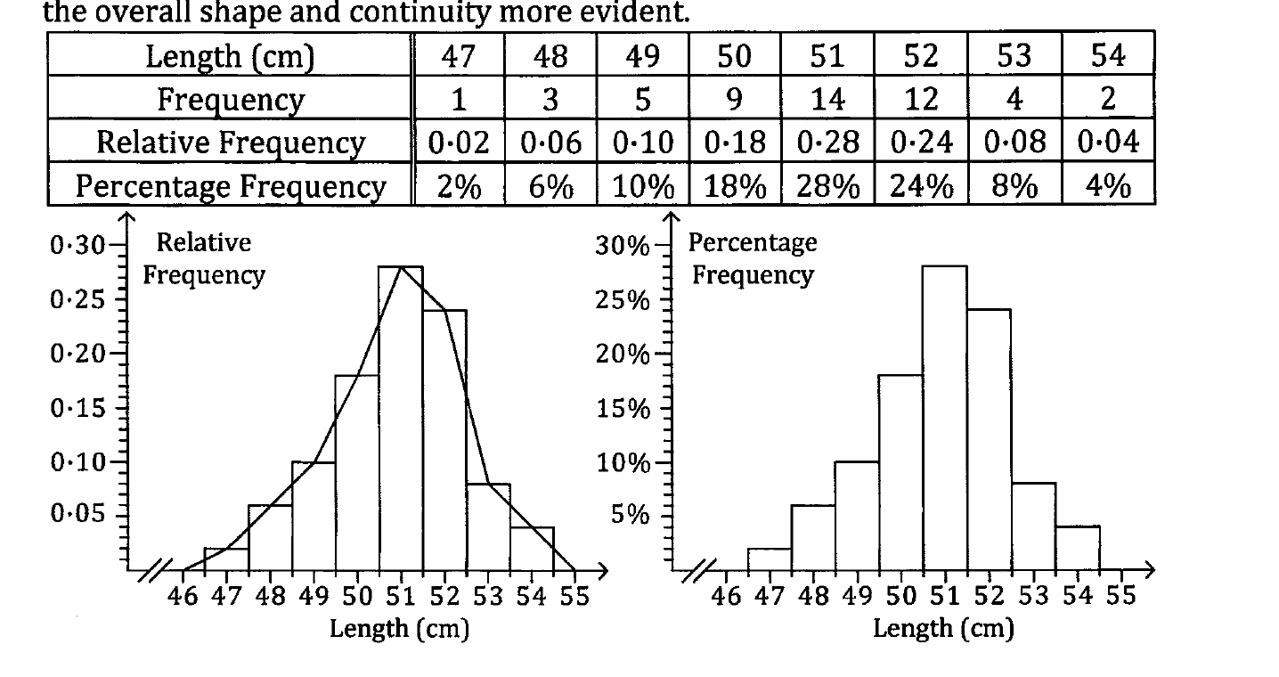
Frequency polygon

Slide 7
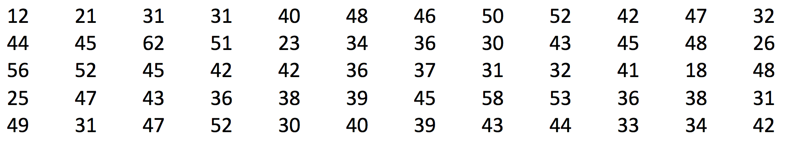
Worksheet
The following data give the number of hours 60 self-employed brick layers worked during a particular week.
a. Represent the data on a frequency distribution table.
b. Draw a histogram of the data.

Slide 8
Determine the interval
Minimum = 12 hours
Maximum = 62 hours

Slide 9
||
||||
||||
||||
||||
||||
||||
||||
||||
||||
|| ||
||||
|||
|

Slide 10
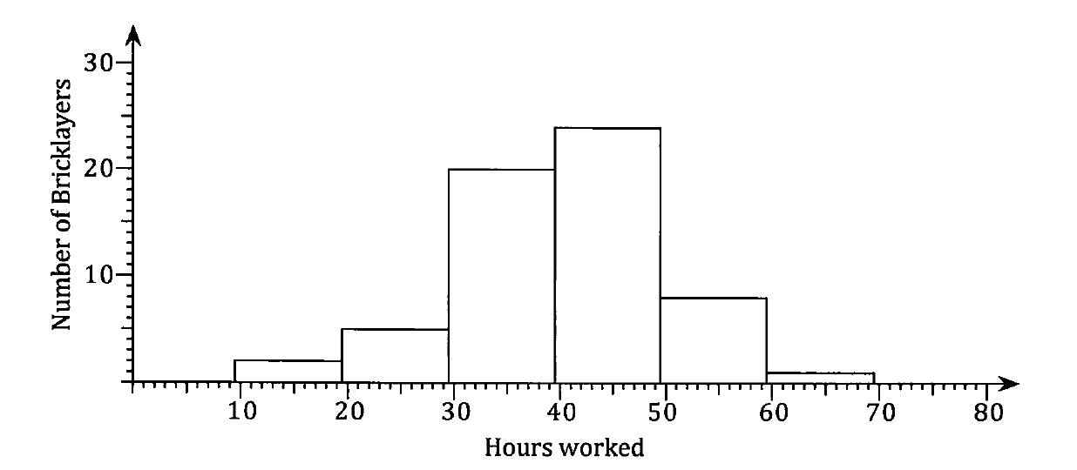
8

Slide 11
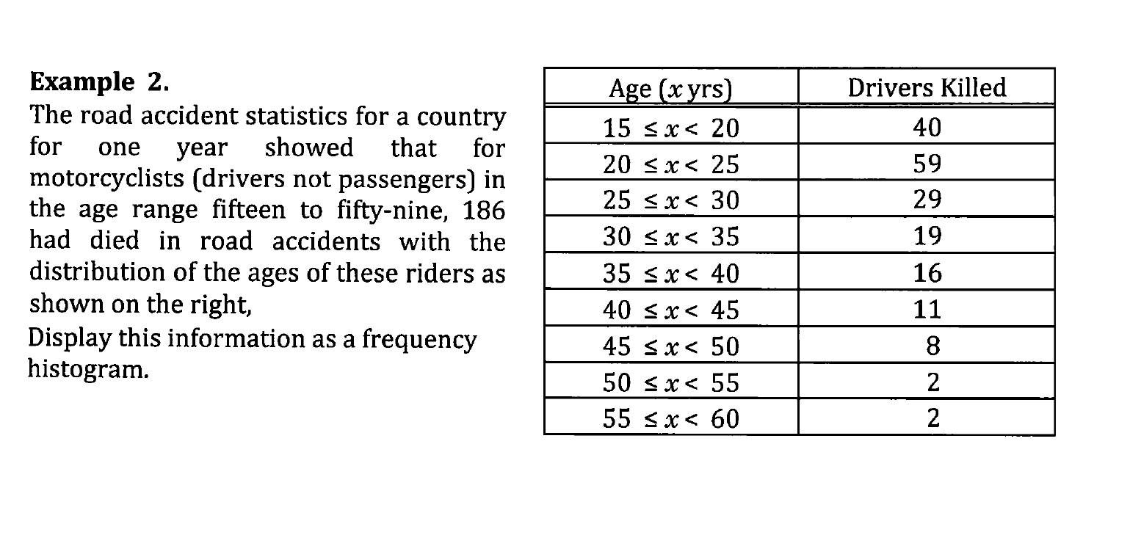

Slide 12
